Slide 1
Clustering Bio Networks, Social Simulation, and Response Prediction
By: Aamir Mandviwalla

Slide 2
Who am I?
Aamir Mandviwalla
3rd year Computer Science PhD student at RPI
Dr. Szymanski is my advisor
B.S. in Mathematics and Computer Science with Teaching from Temple University in 2019

Slide 3
Project 1 – Clustering on Biological networks

Slide 4
Clustering on biological networks
Current estimates: About 20,000 protein-coding genes in humans
  Back in 1990, the Human Genome Project was estimating about 100,000
Only about 2000 of these receive the vast majority of research attention
  The rest are relatively unknown
  It is difficult to get funding to study something that you cannot prove will have any value
Our objective: Try to learn which of these unknown genes will be useful to study
  Idea: Find the genes we already know about that they are most similar to

Slide 5
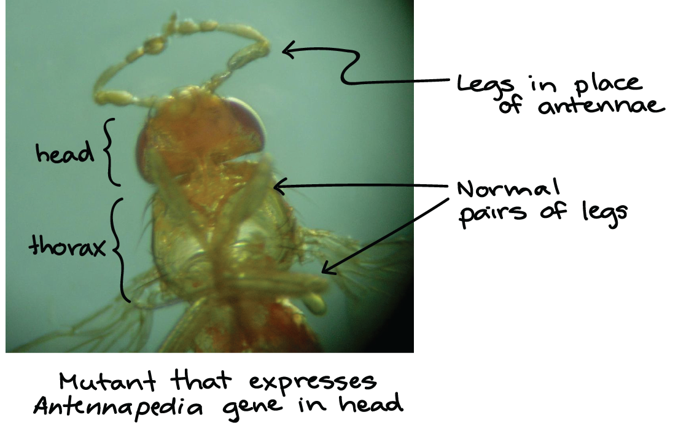
Clustering on biological networks
Studies have found that clustering genes shows great promise
  Genes in the same clusters tend to have similar functions in the body
  A cluster of genes was identified that correlates with risk of severe symptoms when contracting covid-19 Genomewide Association Study of Severe Covid-19 with Respiratory Failure | NEJM
  The Hox gene cluster in animals is famous for strongly correlating with the physical form of the animal Hox Genes in Development: The Hox Code | Learn Science at Scitable (nature.com)

Slide 6
Clustering on biological networks
Gene expression cluster analysis
  Gene expression – when is a gene “turned on” or off?
  Cluster genes based on similarity of on/off times
Gene | A | B | C
Measurement 1 | On | On | Off
Measurement 2 | Off | Off | Off
Measurement 3 | On | On | On
Measurement 4 | Off | Off | Off

Slide 7
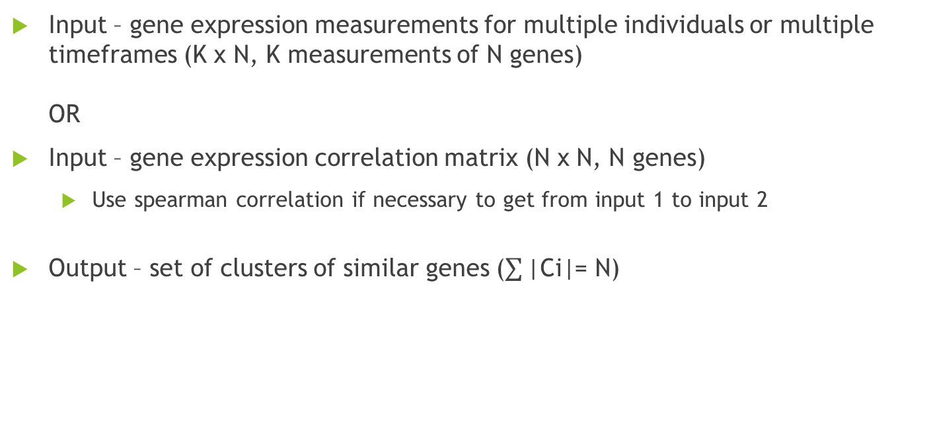
Clustering on biological networks
Input – gene expression measurements for multiple individuals or multiple timeframes (K x N, K measurements of N genes)
OR
Input – gene expression correlation matrix (N x N, N genes)
  Use spearman correlation if necessary to get from input 1 to input 2
Output – set of clusters of similar genes ($\sum{\text{|}\text{Ci}\text{|}}$= N)

Slide 8
Clustering on biological networks
We treat the correlations as weighted edges between the nodes (genes)
We can use a common network clustering algorithm like Louvain or Affinity Propagation
  But due to lack of data – a single clustering may not give us strong results
Simulated annealing to determine strongest network structure
  Shake network (randomly strengthen or weaken edges) repeatedly to determine which clusters break apart easily and which do not
  Freeze strongest clusters and repeat process
  Continue until all clusters are frozen

Slide 9
Clustering on biological networks
Current/Future plan:
Amr Elsisy shared last class (?) his work using entropy to identify strongest network structure in criminal networks
Attempt to combine this work and see if the same entropy patterns hold true for bio networks

Slide 10
Project 2 – Social Simulation

Slide 11
Social Simulation
DARPA challenge –
  Given: large set of social media posts (tweets, youtube comments, reddit threads, etc.)
  Given: each post manually annotated as to whether they relate to certain topics (economy, foreign relations, covid, etc.)
  Challenge: create a model that can simulate future activity related to the same topics on the same platforms

Slide 12
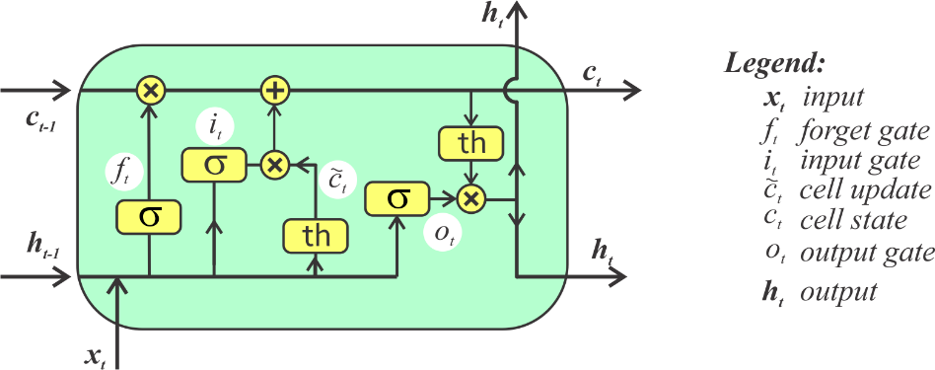
Social Simulation
AMALIA platform:
  Worked on by many students
  Start-to-finish pipeline: goes from raw input dataset to final simulated dataset in one click
  My focus – algorithm to predict volume of activity per topic per day
Long short-term memory (LSTM) artificial recurrent neural network (RNN)

Slide 13
Social Simulation
LSTM simplified:
  Short-term memory:
    What parameters worked best yesterday?
    Update each time-step (each day)
  Long-term memory:
    What long-term patterns can we learn (Sundays always have lower activity?)
    Manually determine sequence length (ex: 7 days)
    State variables for each step of sequence (ex: each day of week)
  Combine the two to determine final output

Slide 14
Social Simulation
Current/Future plan:
Final challenge ended in August
  Official results not released yet
Hybrid model
  Different algorithms (ex: LSTM, Linear Regression, Replay, Decision Tree, etc.) did better at different tasks (ex: some were better at predicting spikes while others were better at simulating regular days)
  Could we train a model to predict which algorithm will have the best prediction on a given day?

Slide 15
Project 3 – Response Prediction

Slide 16
Response Prediction
Predict how individual social media users will act in the future
  Instead of predicting “There will be 10 threads and 70 comments on reddit today with 40 users with the following degree distribution related to the topic of the economy”
  Predict that user A will talk about the economy on reddit today and with a specific stance (ex: positive, negative)
  Predict this for all users for all topics

Slide 17
Response Prediction
First, we must mine some demographic/psychographic attributes about users from the raw posts
  Research has shown that specific word-choice has strong correlations with moral beliefs
Next, we determine which of those attributes correlate strongly with specific stances on each topic
Finally, we can use this knowledge to predict how each user will act

Slide 18
Response Prediction
Dataset - Teenage Friends and Lifestyle Study - Description Teenage Friends and Lifestyle Study data (ox.ac.uk)
  February 1995-January 1997 in Glasgow, Scotland
  129 students measured 3 times (2nd, 3rd, and 4th year at a secondary school, ages 13-15)
  Funded by the Chief Scientist Office of the Scottish Home and Health Department under their Smoking Initiative
  Goal was to “identify processes by which attitudes towards smoking and smoking behavior itself change over early to mid adolescence, focusing particularly on the stage of experimentation, and the transition from experimental to regular smoking”

Slide 19
Response Prediction
Alcohol, tobacco, and cannabis are each individually scored for each student at each measurement point
  from 1 to 5
  1 is no use at all
  5 is regular use
There is a directed adjacency matrix for each measurement between all the students where they mark between 1-3 for each other student
  1 is a “best friend”
  2 is “just a friend”
  3 is “no friend”
Distances from the school, and from every other students’ home, and angle measurements (school vertex, each student’s home are the end points), are recorded as well

Slide 20
Response Prediction
There are additional factors that can be considered:
  how much money did each student have
  were they in a romantic relationship
  did their parents or siblings smoke
  what music do they like
  how frequently do they participate in various leisure activities

Slide 21
Response Prediction
Initial results:
  Students with 1 or more friends that use cannabis are more likely to eventually begin using cannabis than those with 0 such friends
  Students with specific musical tastes are more likely to eventually begin using cannabis

Slide 22
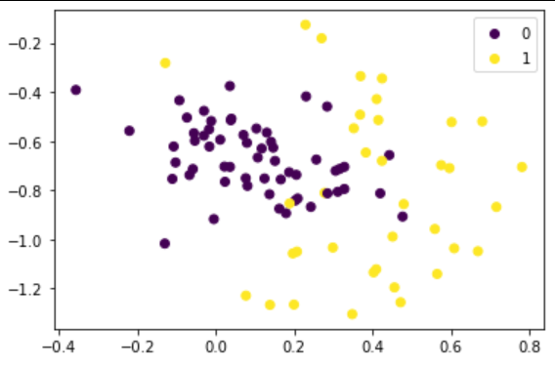
Response Prediction
Proposed Algorithms:
Principal component analysis (PCA) – using all the available features, map students onto a 2D plot where position predicts their likelihood to eventually use cannabis

Slide 23
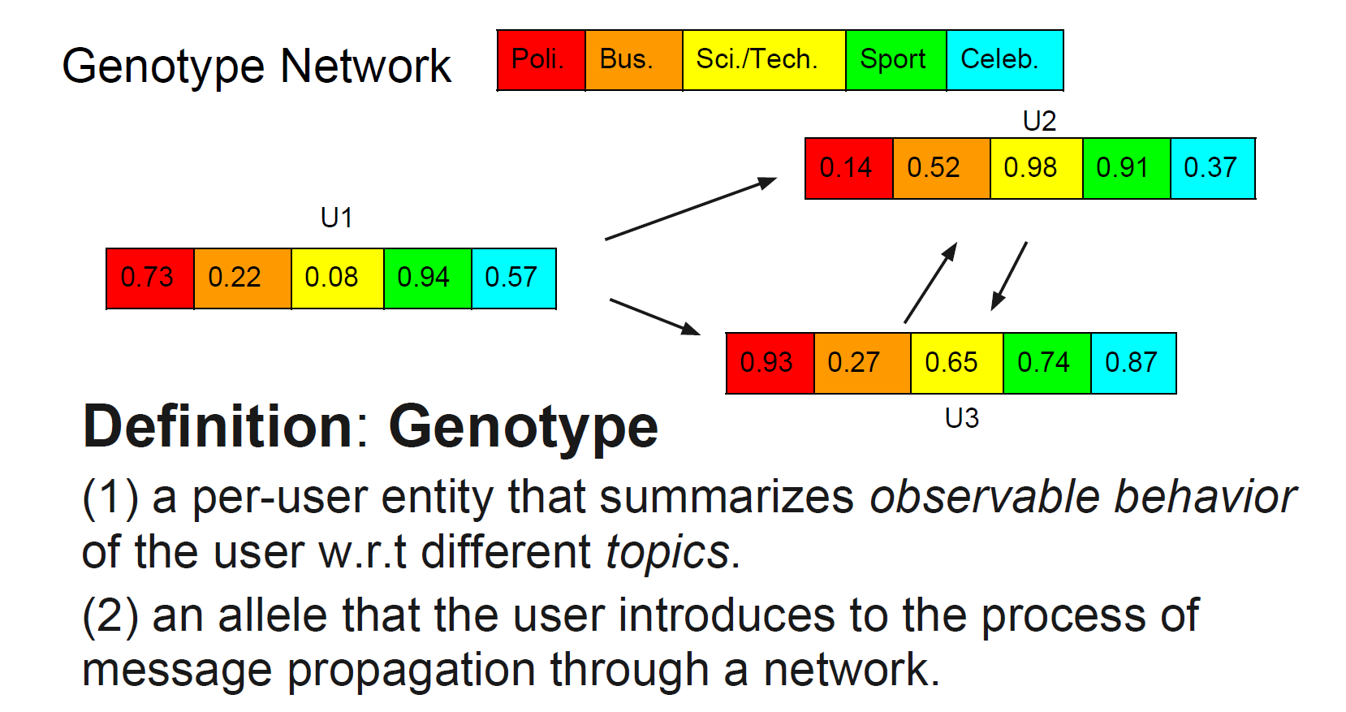
Response Prediction
Proposed Algorithms:
Social Genotypes – Learn the activity patterns related to each topic for every user and then we can use your friends’ patterns to help predict your own

Slide 24
Response Prediction
Current/Future plans:
Winter conference paper comparing and/or combining different methods for response prediction
  Social genotypes, PCA, neural network, decision tree
  Student lifestyle dataset + World Values Survey WVS Database (worldvaluessurvey.org)
Prepare for official challenge (different dataset)

Slide 25
Questions?

